Slide 1
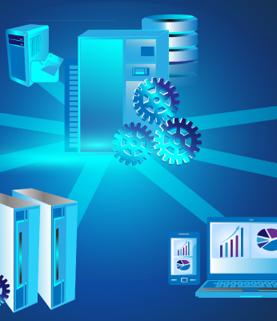
COMP90050
Advanced Database Systems
Winter Semester, 2023
Lecturer: Farhana Choudhury (PhD)
Week 1 part 2

Slide 2
Types of Database Systems
How the data are stored –
Simple file
RDBS
Object oriented
As a plain text file. Each line holds one record, with fields separated by delimiters (e.g., commas or tabs)
As a collection of tables (relations) consisting of rows and column. A primary key is used to uniquely identify each row.
No-SQL
Data stored in the form of ‘objects’ directly (like OOP)
Non relational – database modelled other than the tabular relations. Covers a wide range of database types.
Notes:
//page 23

Slide 3
Simple file
  Usually very fast for simple applications but can be slow for complex applications
  Can be less reliable
  Application dependent optimisation
  Very hard to maintain them (concurrency problems)
  Many of the required features (that exist in relational databases) need to be incorporated - unnecessary code development and potential increase in unreliability
Notes:
As a plain text file. Each line of the file holds one record, with fields separated by delimiters, for example commas or tabs.

Slide 4
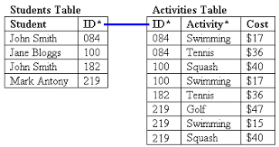
Relational DB systems
  Very reliable (consistency of data – we will learn more later)
  Application independent optimisation
  Well suited to many applications, very fast due to large main memory machines and SSDs.
  Some RDB also support Object Oriented model e.g., Oracle, DB2, and XML data+queries
  Can be slow for some simple applications
Source: http://www.databasedev.co.uk

Slide 5
Object Oriented (OO) DB Systems
  Stores as objects directly, not tables
  May contain both data (attributes) and methods – like OOP
  Can be slow on some applications
  Reliable
  Limited application independent optimisation
  Well suited for applications requiring complex data
  Unfortunately, many commercial systems started did not survive the force of RDB technology and basically disappeared from the market.

Slide 6
NoSQL (also called Not Only SQL)
Flexible/ no fixed schema (unlike RDB)
Provides a mechanism for storage and retrieval of data modelled in means other than the tabular relations
Simple design, should linearly scale
NoSQL has compromise consistency and allows replications - We will discuss this more later.
Most NoSQL databases offer "eventual consistency”, which might result in reading data from an older version, a problem known as stale reads – we will learn more later

Slide 7
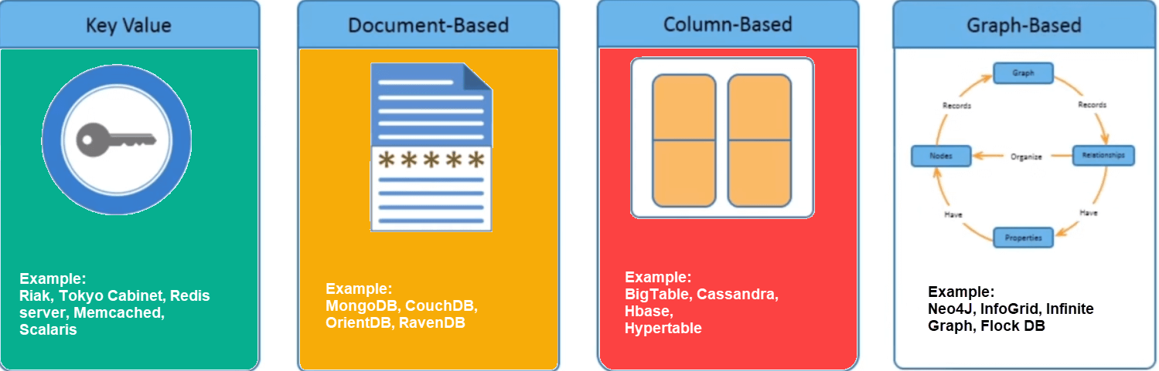
Types of NoSQL databases
Image source: https://jameskle.com/writes/no-sql

Slide 8
Key-value pair database systems
  Stores data as a collection of key–value pairs, where each key is unique
  Why useful - Many applications do not require the expressive functionality of transaction processing – e.g. Web search, Big Data Analytics can use MapReduce technology.
  Can be seen as a type of NoSQL database
  Used for building very fast, highly parallel processing of large data - MapReduce and Hadoop are examples
  Atomic updates at Key-value pair level (row update) only.

Slide 9
Some other DB systems –
Deductive database systems (DDBS)
  Allows recursion
  Most of the application can be developed entirely using DDBS
  There are no commercially available systems like RDBs
  Many applications do not require the expressive power of these systems (e.g. many commerce related applications)
  Many RDBs do provide some of the functionality – e.g. supporting transitive closure operation (a form of recursion in SQL2).
  E.g.
    path(X,Y) :- edge(X,Y).
    path(X,Y) :- edge(X,Z), path(Z,Y).

Slide 10
Database Architectures
Centralized
Distributed
WWW
Grid
P2P
Cloud
Data stored in one location
Data distributed across several nodes, can be in different locations
Stored all over the world, several owners of the data
Like distribu-ted, but each node manages own resource; system doesn’t act as a single unit.
Like grid, but nodes can join and leave network at will (unlike Grid)
Generalization of grid, but resources are accessed on-demand

Slide 11


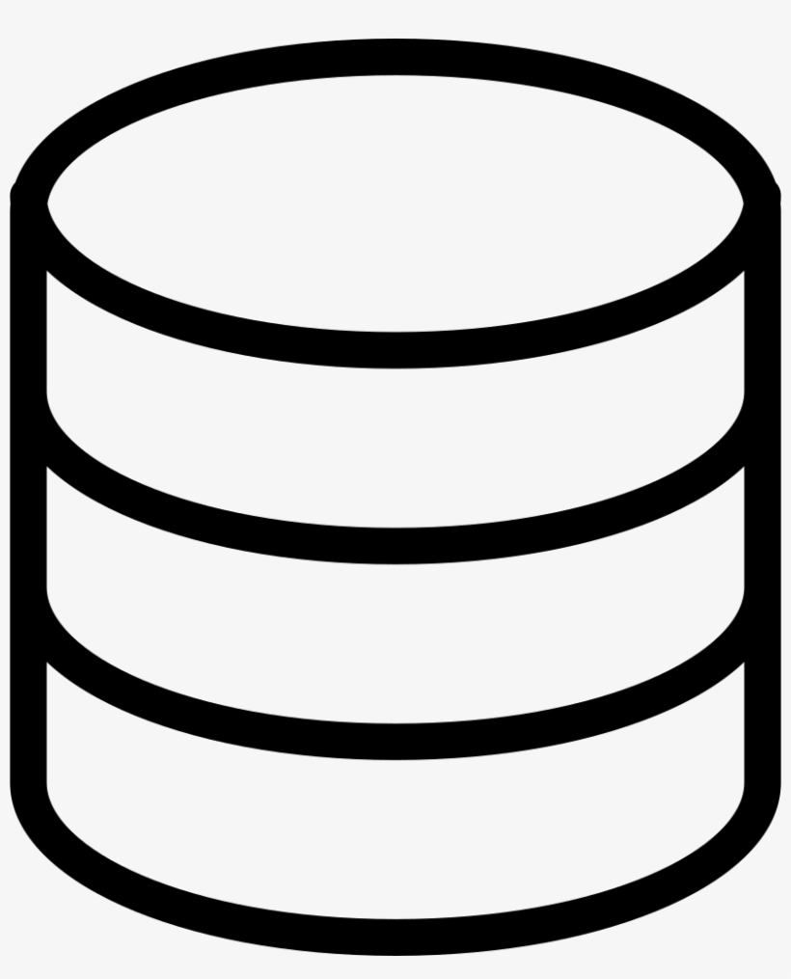
Database Architectures
Centralised database systems
  Data in one location
  System administration is simple
  Optimisation process is generally very effective
  PC/Cluster Computing/data centres are examples of this
Operating system
DBMS
Central computer

Slide 12
Database Architectures
Client-server architecture that uses a centralized database server-
  A central server with a central DB in one location
  (but client and server can be in different locations)
  Client generally provides user interfaces for input and output
  Server provides all the necessary database functionality
  System administration is relatively simple
  System recovery is similar to centralised systems
Server

Slide 13
Database Architectures
Distributed database systems:
  Data is distributed across several nodes in different locations
  Nodes are connected by network
  System provides concurrency, recovery and transaction processing
  System administration is very hard – usually with a single resource manager
  Crash recovery is complicated
  There are usually data replication -- potential inconsistency

Slide 14

Database Architectures
World Wide Web
  Data is stored in many locations
  Several owners of data - no certainty of data availability or consistency
  Optimisation process is generally very ineffective
  Evolving database technology -- no standards have been developed except in case of XML/http and some protocols for accessing data
  Security could be a potential problem
  Notions of Transactions is much more difficult to enforce

Slide 15
Database Architectures
Grid Computing and Databases
  Very similar to distributed database systems
  Data and processing are shared among a group of computer systems which may be geographically separated.
  Usually designed for particular purpose – e.g., a scientific application
  Administration of such systems are done locally by each owner of the system
  Reliability and security of such systems are not well developed or studied.
  Grid systems model is more or less outdated by Cloud Computing model

Slide 16
Database Architectures
P2P Databases
  Data and processing is shared among a group of computer systems which may be geographically separated as in Grid Database systems
  Computer nodes can join and leave the network at will unlike in Grid Databases => much harder to design transaction models
  Usually designed for particular usage – e.g. a scientific application
  Administration of such system is done by the owners of the data

Slide 17
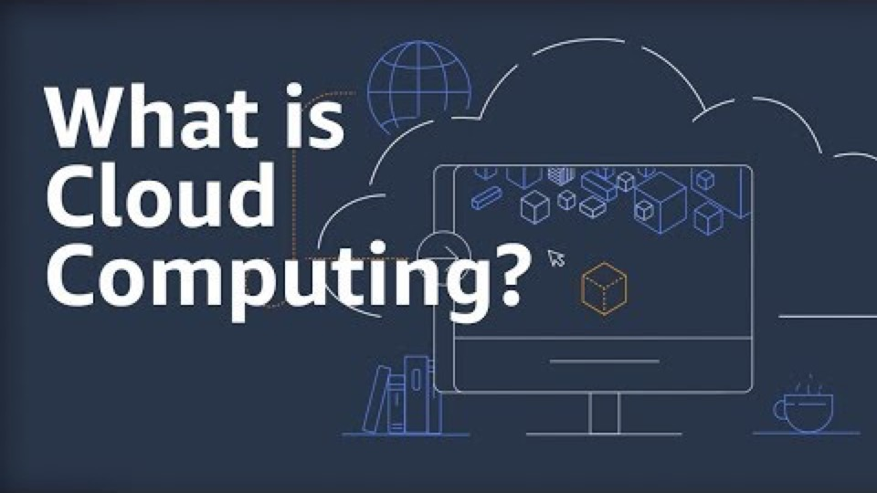
Database Architectures
Cloud computing
https://www.youtube.com/watch?v=dH0yz-Osy54

Slide 18
Database Architectures
Cloud computing
Cloud computing offers online computing, storage and a range of new services for data and devices that are accessible through the Internet.
User pays for the services just like phone services, electricity, etc.
Huge potential for developing applications with minimal infrastructure costs
Cloud services offered in several forms:
  Iaas – Infrastructure as a service (provide virtual machines)
  Paas – Platform as a service (Provide environment like Linux, Windows, etc.)
  Saas – Software as a service (Specific applications like RDB, Mail, etc.)

Slide 19
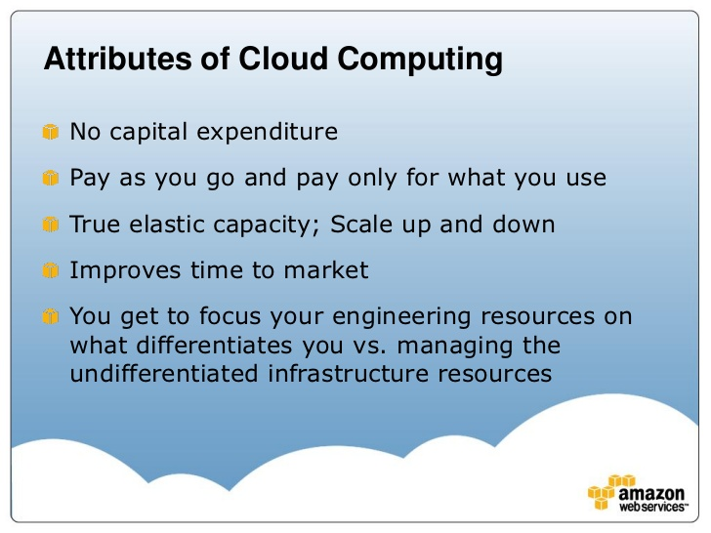
An example: AWS: Amazon Web Services

Slide 20
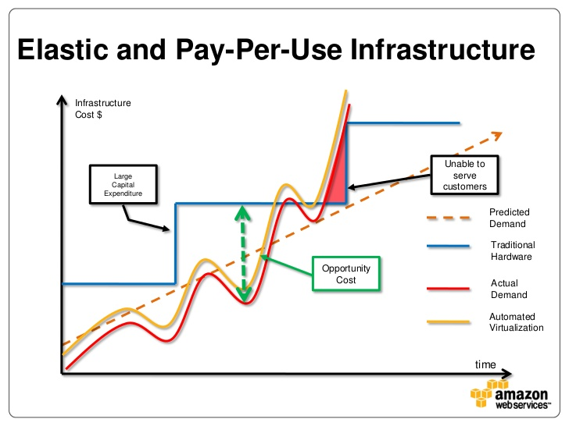

Slide 21
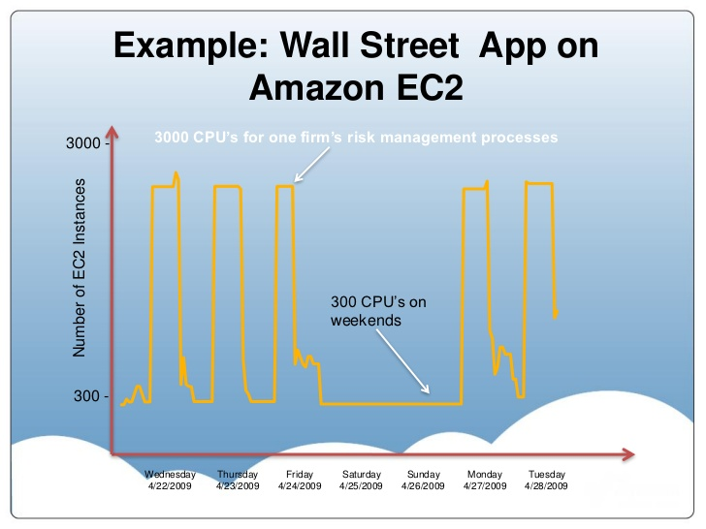
(Elastic Compute Cloud)

Slide 22
Database Architectures
Centralized
Distributed
Grid
P2P
Cloud
Data stored in one location
Data distributed across several nodes, can be in different locations
Stored all over the world, several owners of the data
Like distribu-ted, but each node manages own resource; system doesn’t act as a single unit.
Like grid, but nodes can join and leave network at will (unlike Grid)
Generalization of grid, but resources are accessed on-demand
WWW

Slide 23
Core Concepts of Database management system
Efficiency
- Disks and I/O bandwidth
- Main memory
- Type of architecture
Database performance metrics
Hardware
Software/ DB tuning
- Types of DB
- Indexing
- Query optimisation
Efficiency/speed
Effectiveness
Effectiveness
Concurrent users
Users reading and writing over the same data
Security & Reliability
Transactions
Required tasks are all done together
Reliability
Crash recovery
Fault tolerance
Data duplication

